Slide 1

AI for Business

Slide 2
AGENDA
Application and Examples
What Is AI
Advantages
Challenges

Slide 3

ABOUT ME
the theory and development of computer systems capable of performing tasks normally requiring human intelligence, such as visual perception, speech recognition, decision-making, and language translation

Slide 4
WHAT IS AI
the theory and development of computer systems capable of performing tasks normally requiring human intelligence, such as visual perception, speech recognition, decision-making, and language translation

Slide 5


AI IN BUSINESS
In business, artificial intelligence simply refers to the use of intelligent computer software with human-like capabilities to increase revenue, improve customer experience, increase productivity and efficiency, and drive business growth and transformation.

Slide 6
APPLICATION OF AI IN BUSINESS
Everything should be made as simple as possible.
CUSTOMER SERVICE
BUSINESS INTELLIGENCE
AGRICULTURE
PERSONALIZED AND TARGETED MARKETING
PRODUCT RECOMMENDATION AND PREDICTIVE ANALYTICS
NATURAL LANGUAGE PROCESSING

Slide 7
AI IN CUSTOMER CARE
Customers can now interact with companies in real-time to resolve complaints, place orders, get information, and do almost anything they would require from a conversation with a human customer-care representative, thanks to the introduction of chat-bots.

Slide 8
AI IN CUSTOMER CARE
According to Gartner, by 2020, 85% of customer interactions will be managed without the involvement of a human. This disruptive artificial intelligence in business innovation will eliminate the need for humans in customer interactions, lowering business costs and exponentially improving customer care accessibility and conversational experience.

Slide 9
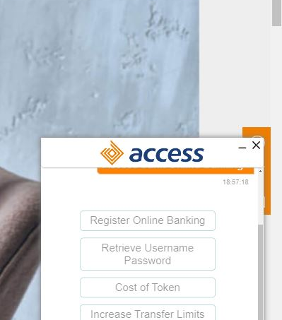


Slide 10
AI IN BUSINESS INTELLIGENCE
In business intelligence, artificial intelligence aids in the extraction of valuable insights from data.

Slide 11
AI IN BUSINESS INTELLIGENCE
These insights assist businesses in improving marketing effectiveness, better understanding customers, segmenting to create personalized experiences, developing business strategies to aid corporate decision making, and leveraging artificial intelligence in business management.

Slide 12
AI IN BUSINESS INTELLIGENCE
There are numerous tools available today that use artificial intelligence in business intelligence. Microsoft Power BI is a popular tool that helps businesses obtain key analytics to determine which strategies and decisions have the greatest impact on business metrics.

Slide 13
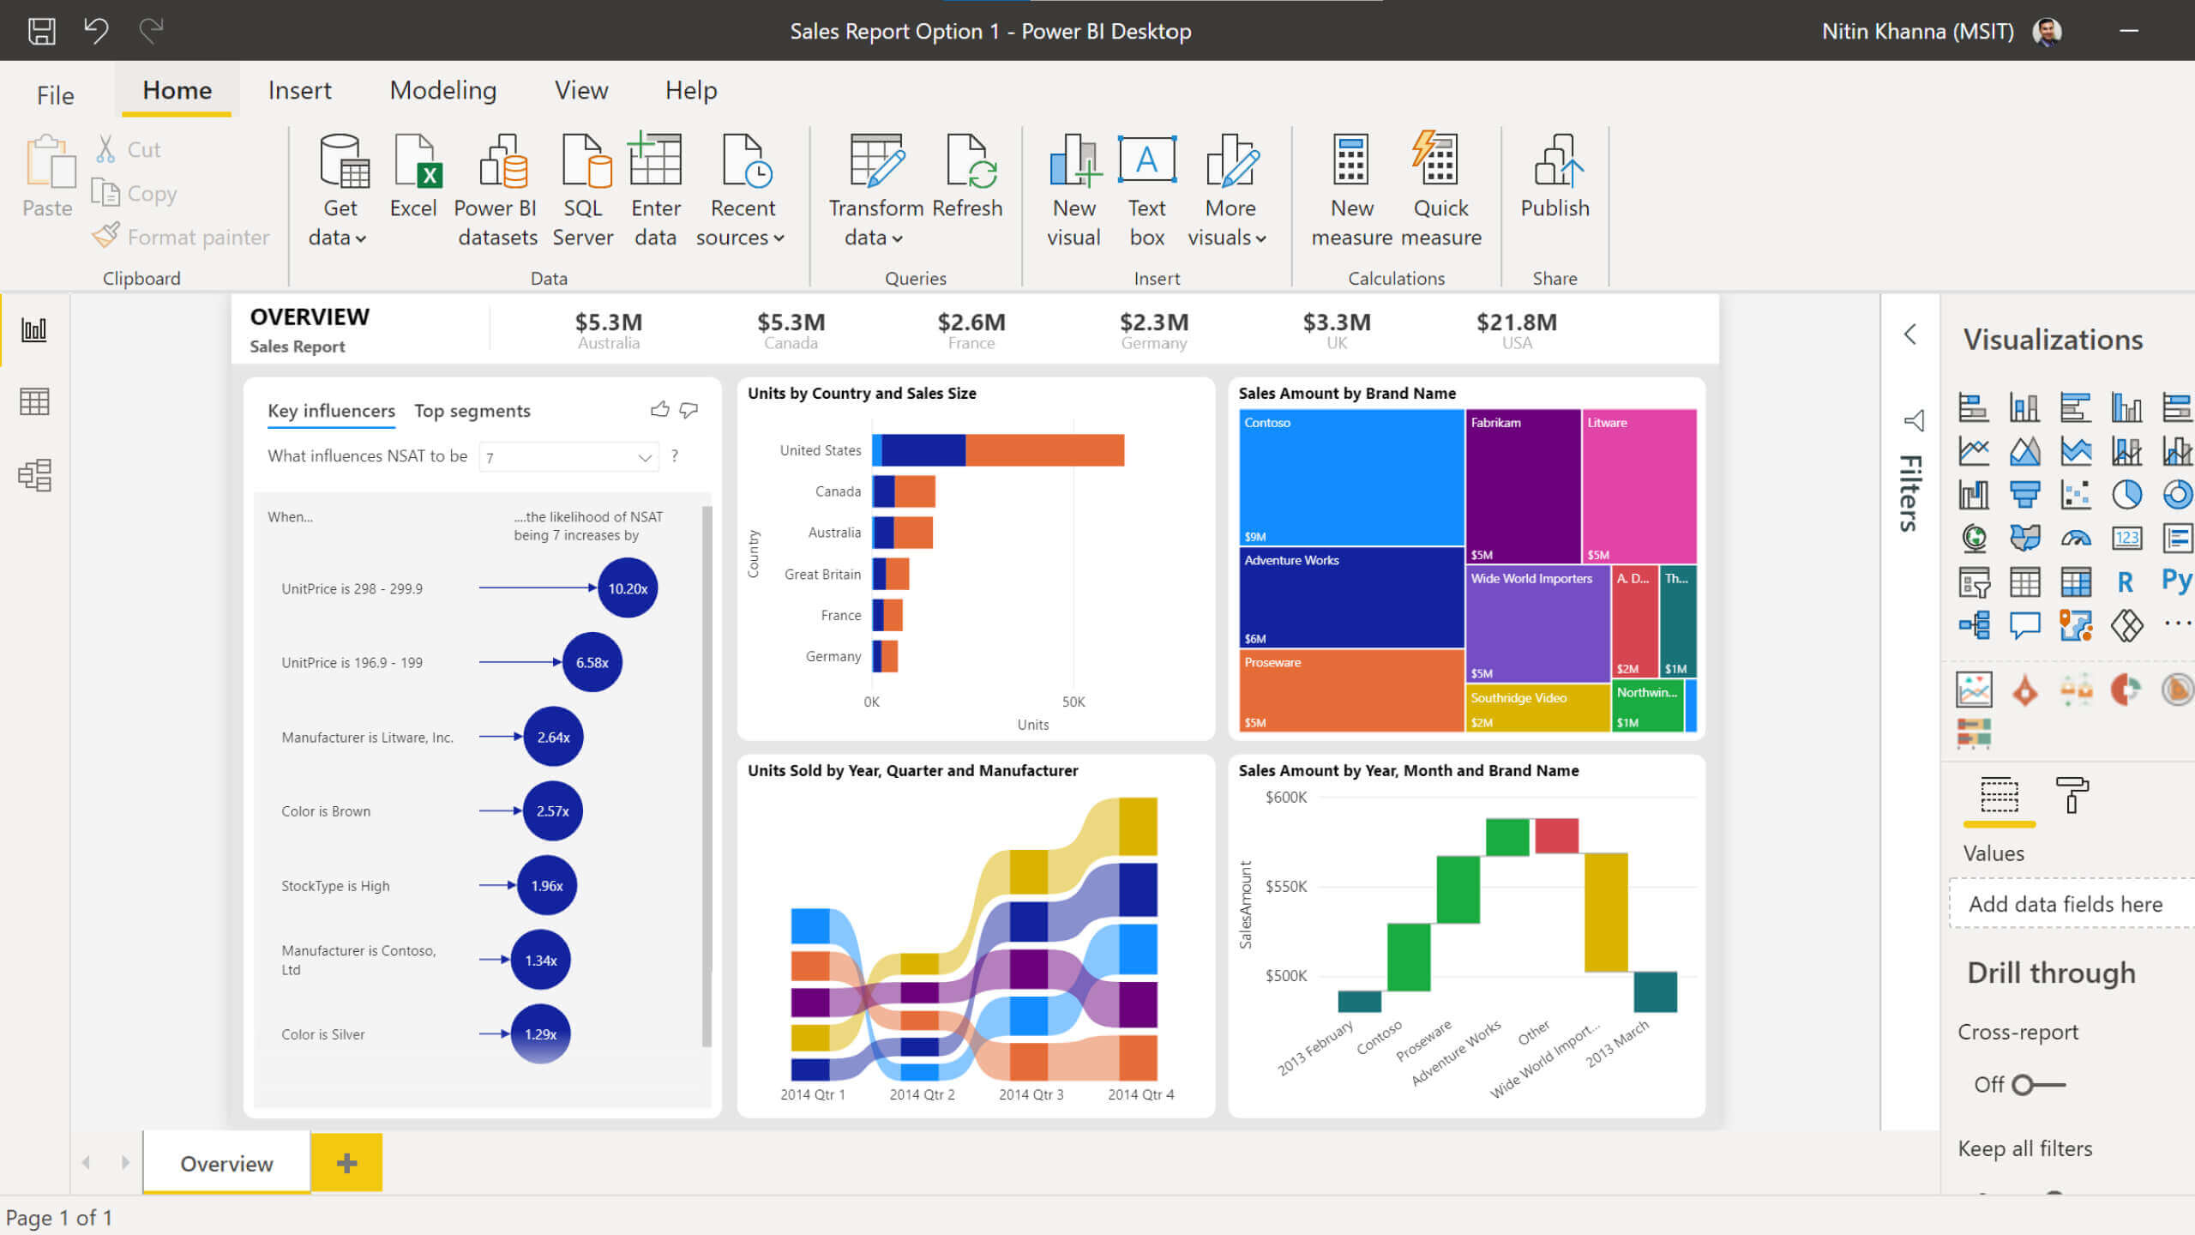
AI for Business

Slide 14
CUSTOMER SEGMENTATION
DROP GITHUB LINK.

Slide 15
AI IN NATURAL LANGUAGE PROCESSING
Today, businesses utilize AI to create automated financial reports that run independently of human oversight. They also employ sentiment analysis to determine how various online reviews, tweets, and other communications about the firm affect people's perceptions of the brand.

Slide 16
AI IN NATURAL LANGUAGE PROCESSING
Businesses can continually learn how customers feel about their goods and services by using sentiment analysis. This enhances the quality of services and offers for customized products.

Slide 17
AI for Business

Slide 18
APPLICATION OF AI
AGRICULTURE
PERSONALIZED AND TARGETED MARKETING
PRODUCT RECOMMENDATION AND PREDICTIVE ANALYTICS
AI is used to detect diseases and pests in plants
AI is used to predict and target who to market a particular product to.
AI is used to provide song or video recommendations that each user may likely enjoy. Spotify, YouTube.
Nullam eu tempor purus. Nunc a leo magna, sit amet consequat risus. Etiam faucibus tortor

Slide 19
Advantages Of AI
Automation of processes
More positive results from marketing activities and increased revenue
Better understanding of customers and improved experience of services offered
Fraud detection

Slide 20
Challenges Of AI
Data Scarcity
Algorithm Bias
Limitations in current computing capability
Issues of threats to data security and privacy

Slide 21

THANK YOU

Slide 22
ABOUT ME
the theory and development of computer systems capable of performing tasks normally requiring human intelligence, such as visual perception, speech recognition, decision-making, and language translation

